Slide 1
File System Mounting
Mounting refers to the grouping of files in a file system structure accessible to the user of the group of users.
It can be local or remote, in the local mounting, it connects disk drivers as one machine, while in the remote mounting it uses Network File System (NFS) to connect to directories on other machines so that they can be used as if they are the part of the user’s file system.
The directory structure can be built out of multiple volumes which are supposed to be mounted to make them available within the file-system namespace.
The procedure for mounting is simple, the OS is given the name of the device and the location within the file structure where the file system is attached.

Slide 2
For example, in a UNIX system, there is a single directory tree, and all the accessible storage must have a location in the single directory tree.
Mounting is used to make the storage accessible.
A file system containing the user’s home directories might be mounted as /home, and they can be accessed by using directory names with time like /home/janc.
Similarly, if the file system is mounted as /user, then we will use /user/janc to access it.
Then the operating system verifies if the device contains a valid file system by asking the device driver to read the directory and verify that the directory has the expected format.
Then the operating system finally notes down the directory structure that the file system is mounted at the specified mount point.

Slide 3
This method helps the operating system traverse through the directory structure and switch among file systems as appropriate.
A system may either allow the same file system to be mounted repeatedly on different mount points or it may allow one mount per file system.
For example, the Macintosh operating system. In this whenever the system encounters a disk for the first time, it searches for the file system in the disk, and if it finds one it automatically mounts the system at the root level and adds a folder icon on the screen labelled as the name of the file system. The Microsoft OS maintains a two-level directory structure.

Slide 4
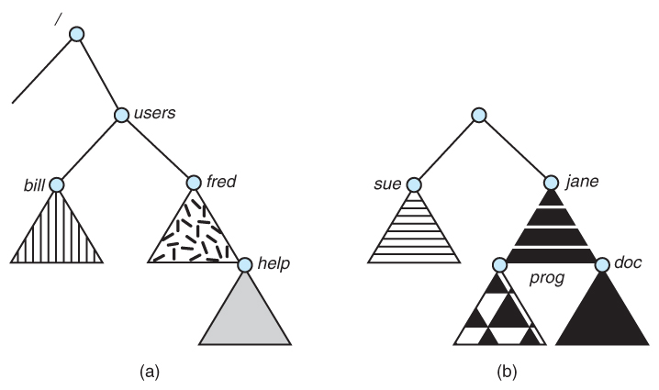
Existing system
Unmounted volume

Slide 5
File sharing
File sharing is the practice of distributing or providing access to digital files between two or more users or devices.
While it is a convenient way to share information and collaborate on projects, it also comes with risks such as malware and viruses, data breaches, legal consequences, and identity theft.
Protecting files during sharing is essential to ensure confidentiality, integrity, and availability.
Encryption, password protection, secure file transfer protocols, and regularly updating antivirus and anti-malware software are all important measures that can be taken to safeguard files.
This article will explore the different types of file sharing, risks associated with file sharing, protection measures, and best practices for secure file sharing.

Slide 6
1. MULTIPLE USERS:
When an operating system accommodates multiple users, the issues of file sharing, file naming and file protection become preeminent.
The system either can allow user to access the file of other users by default, or it may require that a user specifically grant access to the files. These are the issues of access control and protection.
To implement sharing and protection, the system must maintain more file and directory attributes than a on a single-user system.
The owner is the user who may change attributes, grand access, and has the most control over the file or directory.

Slide 7
The group attribute of a file is used to define a subset of users who may share access to the file.
Most systems implement owner attributes by managing a list of user names and associated user identifiers (user Ids).
When a user logs in to the system, the authentication stage determines the appropriate user ID for user. That user ID is associated with all of user’s processes and threads.
When they need to be user readable, they are translated, back to the user name via the user name list.
Likewise, group functionality can be implemented as a system wide list of group names and group identifiers.
Every user can be in one or more groups, depending upon operating system design The user’s group Ids is also included in every associated process and thread.

Slide 8
Remote File System:
Networks allowed communications between remote computers.
Networking allows the sharing or resource spread within a campus or even around the world.
One obvious resource to share is data in the form of files.
The first implemented method involves manually transferring files between machines via programs like ftp.
The second major method uses a distributed file system (DFS) in which remote directories is visible from the local machine.
In some ways, the third method, the World Wide Web, is a reversion to the first. A browser is needed to gain access to the remote file and separate operations (essentially a wrapper for ftp) are used to transfer files.

Slide 9
FTP is used for both anonymous and authenticated access.
Anonymous access allows a user to transfer files without having an account on the remote system.
The world wide web uses anonymous file exchange almost exclusively.
DFS involves a much tighter interaction between the machine that is accessing the remote files and the machine providing the files.

Slide 10
a. The client-server Model:
Remote file systems allow a computer to a mount one or more file systems from one or more remote machines.
In this case, machine containing the files is the server and the, machine seeking access to the files is the client.
A server can serve multiple clients, and a client can use multiple servers, depending on the implementation details of a given client –server facility.
The server usually specifies the available files on a volume or directory level.
Client identification is more difficult. Clients can be specified by their network name or other identifier, such as IP address, but these can be spoofed (or imitate).
An unauthorized client can spoof the server into deciding that it is authorized, and the unauthorized client could be allowed access.

Slide 11
b) Distributed Information systems:
To make client server systems easier to manage, distributed information systems, also known as distributed naming services, provide a unified access to the information needed for remote computing.
Domain name system (DNS) provides host-name-to-network address translations for their entire Internet (including the World Wide Web).
Before DNS was invented and became widespread, files containing the same information were sent via e-mail of ftp between all networked hosts.
In case of Microsoft’s Common Internet File System (CIFS), network information is used in conjunction with user authentication (user name and password) to create a network login that the server uses to decide whether to be valid, the user names must match from machine to machine.

Slide 12
c) Failure Modes:
Local file system can fail for a variety of reasons, including failure of the disk containing the file system, corruption of the directory structure or other disk management information, disk controller failure and host adapter failure.
Remote file system has more failure modes. Because of complexity of network system and the required interactions between remote machines, many more problems can interfere with the proper operation of remote file systems.
Remote file systems add new failure modes, due to network failure , server failure.
In the case of network, the networks can be interrupted between two hostes.
Such interruptions can result from hardware failure, poor hardware configuration, or networking implementation issues.

Slide 13
Consistency Semantics:
Consistency Semantics is concept which is used by users to check file systems which are supporting file sharing in their systems.
Basically, it is specification to check that how in a single system multiple users are getting access to same file and at same time.
They are used to check various things in files, like when will modification by some user in some file is noticeable to others.

Slide 14
(i) UNIX Semantics:
The UNIX file system uses the following consistency semantics:
Writes to an open file by a user are visible immediately to other users that have this file open at the same time.
One mode of sharing allows users to share the pointer of current location into the file. Thus, the advancing of the pointer by one user affects all sharing users.

Slide 15
(ii) Session Semantics:
The Andrew file system (AFS) uses the following consistency semantics:
Writes to an open file by a user are not visible immediately to other users that have the same file open simultaneously.
Once a file is closed, the changes made to it are visible only in sessions starting later. Already open instances of the file do not reflect this change.
(iii) Immutable –shared File Semantics:
Once a file is declared as shared by its creator, it cannot be modified.
An immutable file has two key properties:
Its name may not be reused and its contents may not be altered.

